Slide 1
Chapter 6
Perfectly Competitive Supply
© 2019 McGraw-Hill Education. All rights reserved. Authorized only for instructor use in the classroom. No reproduction or distribution without the prior written consent of McGraw-Hill Education.

Slide 2
Learning Objectives
Explain how opportunity cost is related to the supply curve.
Discuss the relationship between the supply curve for an individual firm and the market supply curve for an industry.
Determine a perfectly competitive firm’s profit-maximizing output level and profit in the short and long run.
Connect the determinants of supply with the factors that affect individual firms’ costs and apply the theory of supply.
Define and calculate producer surplus.

Slide 3
Productivity Changes Over Time
Productivity can be measured by looking at the time it takes a worker to produce a good
Productivity in manufacturing has increased
Assembling a car
Productivity in services has grown more slowly
Orchestras require the same number of musicians
Barbers take just as long to cut hair
Manufacturing wages and service wages increase at about the same rate
Principle of Opportunity Cost

Slide 4
Buyers and Sellers
Cost-Benefit Principle is behind decision making
Buyers: buy one more unit?
Only if marginal benefit is at least as great as marginal cost
Sellers: sell one more unit?
Only if marginal benefit (marginal revenue) is at least as great as marginal cost
Opportunity Cost also matters
Buyers: hamburger or pizza?
Sellers: recycle aluminum or wash dishes?

Slide 5
The Importance of Opportunity Cost
Harry can divide his time between two activities:
Wash dishes for $6 per hour
Recycle aluminum cans and earn 2¢ per can
Harry only cares about the income
How much labor should Harry supply to each activity?
Harry should devote an additional hour to recycling as long as he is earning at least $6 per hour

Slide 6

Recycling Services 1
Hours per Day | Total Number of Containers Found
0 | 0
1 | 600
2 | 1,000
3 | 1,300
4 | 1,500
5 | 1,600
Additional Number of Cans Found
600
400
300
200
100

Slide 7
Recycling Services 2
Hours per Day | Additional Number of Cans Found | Revenue from Additional Cans
1 | 600 | $12.00
2 | 400 | $8.00
3 | 300 | $6.00
4 | 200 | $4.00
5 | 100 | $2.00
Harry earns more than $6 for each of the first two hours
Third hour is a tie with washing dishes
Harry's rule is to collect cans if the return is at least as great as washing dishes
Harry spends 3 hours recycling

Slide 8
Recycling Services 3
Suppose the deposit goes up to 4¢ per can
Harry will spend 4 hours per day recycling
Suppose Harry's dishwashing wage increases to $7
Deposit stays at 2 ¢ each
Harry collects cans for 2 hours a day
Harry recycles more if:
Can deposit increases
Dish-washing wage decreases
Hours per Day | Additional Number of Cans Found
1 | 600
2 | 400
3 | 300
4 | 200
5 | 100

Slide 9
Reservation Price Per Can
What is the lowest deposit per can that would get Harry to recycle for an hour?
What price makes his wage at recycling equal to his opportunity cost?
1st hour price is 1¢
2nd hour is 1.5¢
3rd hour is 2¢
4th hour is 3¢
5th hour is 6¢
Hours per Day | Additional Number of Cans Found
1 | 600
2 | 400
3 | 300
4 | 200
5 | 100

Slide 10
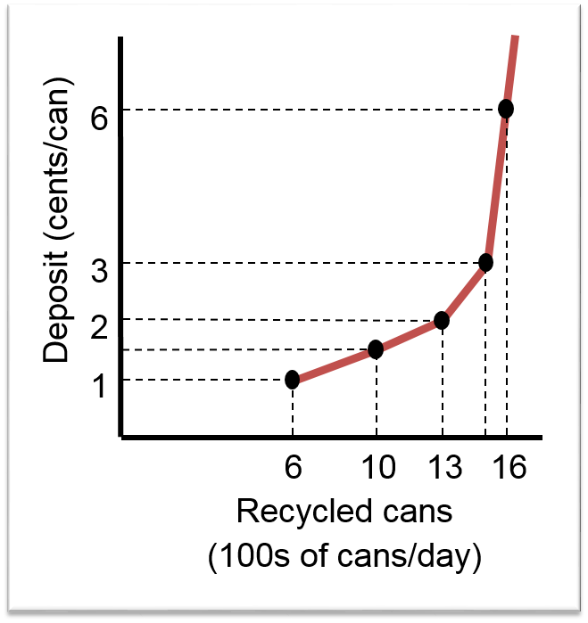
Harry’s Supply Curve
Reservation Price (¢) | Number of Cans (100s)
1 | 6
1.5 | 10
2 | 13
3 | 15
6 | 16

Slide 11
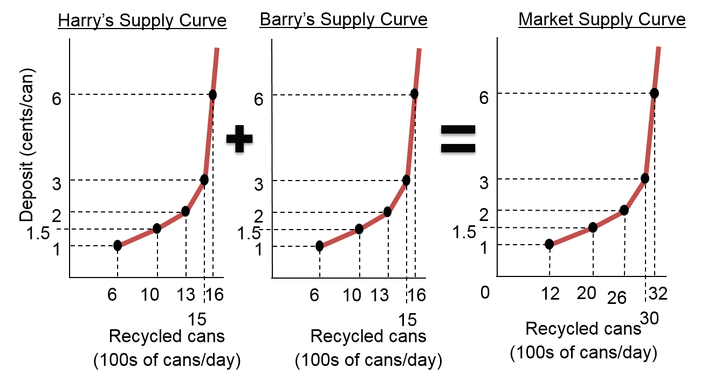
Individual and Market Supply Curves
Harry has an identical twin, Barry

Slide 12
Supply Curves with Positive Slopes
Principle of Increasing Opportunity Cost
First search areas where cans are easy to find
Then go to areas with fewer cans or less accessibility
Higher recycling prices attract new suppliers
Supply curves slope up because
Marginal costs increase, and
Higher prices bring new suppliers

Slide 13
Profit Maximization
Goods and services are produced by different organizations with different motives:
Profit maximizing firms
Nonprofit organizations
Governments
Most goods and services are sold by profit maximizing firms
Economists assume the goal of the firm is to maximize profit
Profit is total revenue minus total cost
Total cost includes explicit and implicit costs

Slide 14
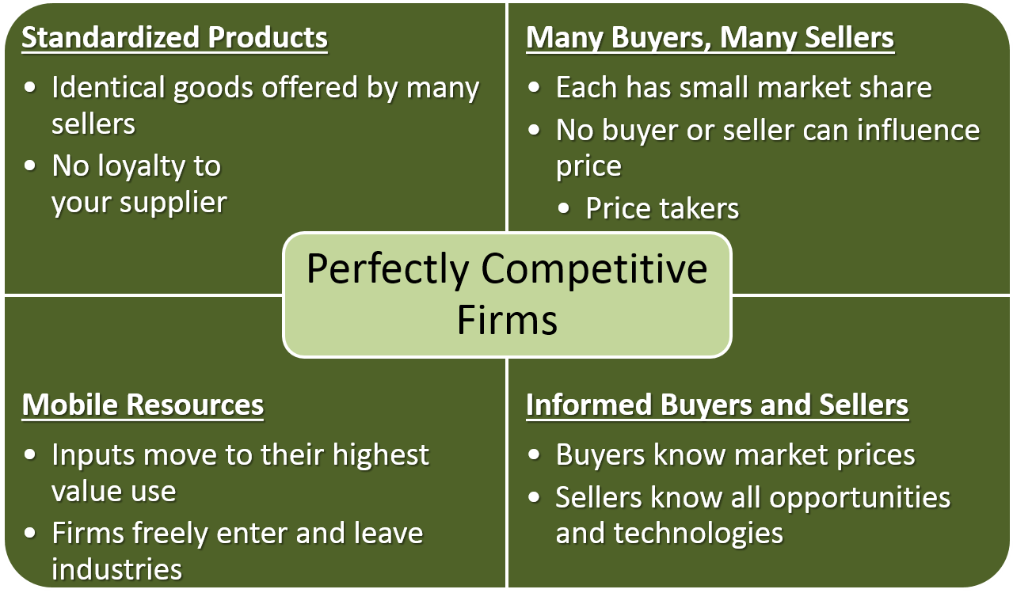
Perfectly Competitive Firms

Slide 15
Perfectly Competitive Firm’s Demand
Market supply and market demand set the price
Buyers and sellers take price (P) as given
Perfectly competitive firm can sell all it wants at the market price
Since the firm is small, its output decision will not change market price
Each firm must decide how much to supply (Q)
Imperfectly competitive firms have some control over price
Some similarities to perfectly competitive firms

Slide 16
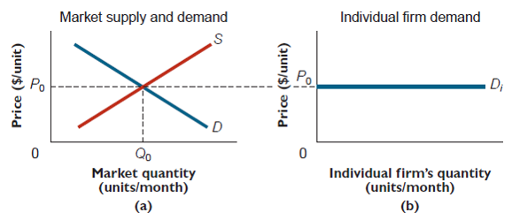
Perfectly Competitive Firm's Demand

Slide 17
Production Ideas
Production converts inputs into outputs
Many different ways to produce the same product
Technology is a recipe for production
A factor of production is an input used in the production of a good or a service
Examples are land, labor, capital, and entrepreneurship
The short run is the period of time when at least one of the firm's factors of production is fixed
The long run is the period of time in which all inputs are variable

Slide 18
Production Data
Number of employees per day | Total number of bottles per day
0 | 0
1 | 80
2 | 200
3 | 260
4 | 300
5 | 330
6 | 350
7 | 362

Slide 19
Production in the Short Run
A perfectly competitive firm has to decide how much to produce
Start by evaluating the short run
The firm produces a single product (glass bottles) using two inputs (workers and a bottle-making machine)
Labor is a variable factor – it can be changed in the short run
Bottle-making machine (capital) is a fixed factor – it cannot be changed in the short run
Determine the profit maximizing level of output

Slide 20
Law of Diminishing Returns 1
When some factors of production are
fixed, increased production of the good
eventually requires ever larger increases in the variable factor

Slide 21
Law of Diminishing Returns 2
At low levels of production, the law of diminishing returns may not hold
Gains from specialization
Similar to the increase in a buyer’s marginal utility from a second unit
Diminishing returns eventually sets in and is often caused by congestion
Only so many people can fit into the office
Only one worker can use the machine at a time

Slide 22
Cost Concepts
Fixed cost (FC) is the sum of all payments for fixed inputs
The $40 per day for the bottle machine
Often referred to as the capital cost
Variable cost (VC) is the sum of all payments for variable inputs
The total labor cost
Total cost (TC) is the sum of all payments for all inputs
Fixed cost plus variable cost
Marginal cost (MC) is the change in total cost divided by the change in output

Slide 23
Find the Output Level that Maximizes Profit
Profit = total revenue − total cost
Total revenue comes from selling the bottles
Total cost = labor (fixed) cost + capital (variable) cost
The firm must know about both revenues and costs in order to maximize profits
Increase output if marginal benefit is at least as great as the marginal cost
Decrease output if marginal benefit is greater than marginal cost

Slide 24
Maximizing Profit
Workers per day | Bottles per day | Fixed cost ($/day) | Variable cost ($/day) | Total cost ($/day) | Marginal cost ($/bottle)
0 | 0 | 40 | 0 | 40 | 0.15
1 | 80 | 40 | 12 | 52 | 0.10
2 | 200 | 40 | 24 | 64 | 0.20
3 | 260 | 40 | 36 | 76 | 0.30
4 | 300 | 40 | 48 | 88 | 0.40
5 | 330 | 40 | 60 | 100 | 0.60
6 | 350 | 40 | 72 | 112 | 1.00
7 | 362 | 40 | 84 | 124

Slide 25
Fixed Cost and Profit Maximization
The profit maximizing quantity does not depend on fixed cost
A firm should increase output only if the extra benefit exceeds the extra cost (cost-benefit principle)
The extra benefit is the price
The extra cost is the marginal cost – the amount by which total cost increases when production rises
The competitive firm produces where price equals marginal cost
When diminishing returns apply, marginal cost rises as production increases

Slide 26
Shut-Down Decision
Firms can make losses in the short run
Some firms continue to operate
Some firms shut down
The Cost – Benefit Principle applies even to losses
Continue to operate if your losses are less than if you shut down
Shut down if your losses are less than if you continued operating

Slide 27
Shut-Down Condition
If the firm shuts down in the short run, it loses all of its fixed costs
So, fixed costs are the most a firm can lose
The firm should shut down if revenue is less than variable cost: P × Q < VC for all levels of Q
The firm is losing money on every unit it makes
If the firm's revenue is at least as big as variable cost, the firm should continue to produce
Each unit pays its variable costs and contributes to fixed costs
Losses will be less than fixed costs

Slide 28
AVC and ATC
Average values are the total divided by quantity
Average variable cost (AVC) is
AVC = VC / Q
Average total cost (ATC) is
ATC = TC / Q
Shut-down if
Shut down if price is less than average variable cost

Slide 29
Profitable Firms
A firm is profitable if its total revenue is greater than its total cost
TR > TC OR
P × Q > ATC × Q since ATC = TC / Q
Another way to state this is to divide both sides of the inequality by Q to get
P > ATC
As long as the firm's price is greater than its average total costs, the firm is profitable

Slide 30
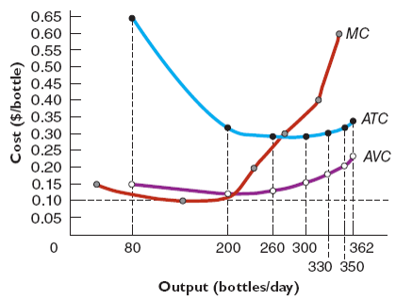
Cost Curves
Workers per day | Bottles per day | Variable Cost ($/day) | AVC ($ per unit) | Total Cost | ATC ($ per unit)
0 | 0 | 0 |  | 40
1 | 80 | 12 | 0.15 | 52 | 0.65
2 | 200 | 24 | 0.12 | 64 | 0.32
3 | 260 | 36 | 0.138 | 76 | 0.292
Marginal Cost ($/unit)
0.15
0.10
0.20
Access the text alternative for these images

Slide 31
Graphical Profit Maximization 1
Market price is $0.20 per bottle
Produce where the marginal benefit of selling a bottle (price) equals the marginal cost
260 bottles per day
Access the text alternative for these images

Slide 32
Graphical Profit Maximization 2
At a price of $0.20, the firm produces 260 bottles
Profit is TR − TC or
(P − ATC) × Q
On the graph, (P − ATC) is profit per unit of output
It is the distance between P = $0.20 and the ATC curve
Profit is the area of the rectangle with height (P − ATC) and width Q
($0.08) (260) = $20.80
Access the text alternative for these images

Slide 33
Losses
Losses can also be shown on a graph
When P < ATC, the firm loses (P − ATC) per unit of output
Total losses are the rectangle whose height is ATC − P and whose width is Q
Losses = (ATC − P) (Q)
($0.10 − $0.08) (180) = $3.60
Access the text alternative for these images

Slide 34
“Law” of Supply
Short-run marginal cost curves have a positive slope
Higher prices generally increase quantity supplied
In the long run, all inputs are variable
Long-run supply curves can be flat, upward sloping, or downward sloping
The perfectly competitive firm’s supply curve is its marginal cost curve
At every quantity on the market supply curve, price is equal to the seller's marginal cost of production
Applies in both the short run and the long run

Slide 35
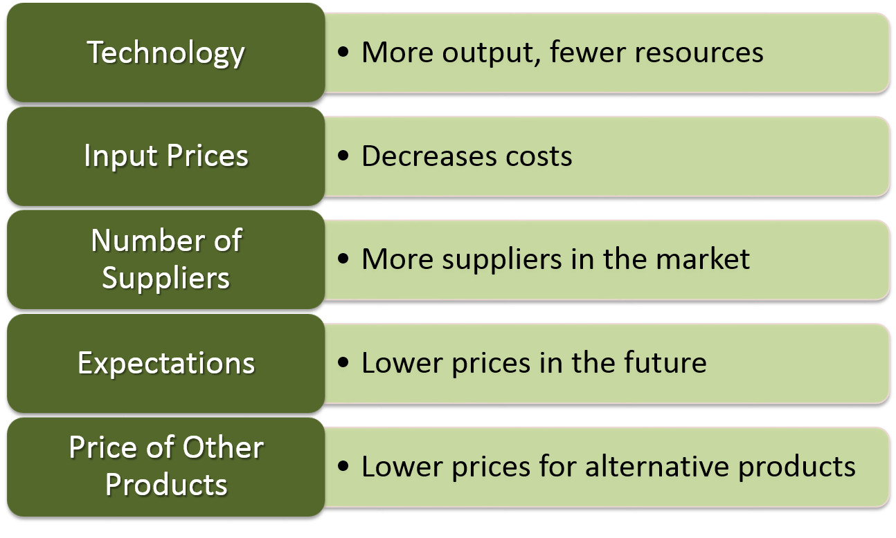
Increases in Supply

Slide 36
More Aluminum than Glass Recycled
Collect recyclable materials until the marginal benefit equals the marginal cost
Recycling aluminum is relatively low cost, so scrap aluminum is in high demand
Relatively high redemption price
Glass is made from low-cost materials
Demand for used glass is low and so is its price
If market forces direct the recycling, more aluminum than glass is collected

Slide 37
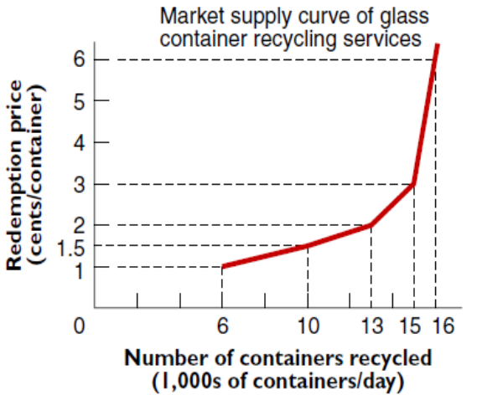
Optimal Amount of Glass Recycling
Glass bottles litter roadways and public places
Market price for used glass is too low to get the bottles recycled
People are willing to pay 6¢ to have glass bottles picked up
Government collects a tax and pays recyclers 6 ¢ per bottle
Graph shows that 16,000 glass containers will be collected and recycled

Slide 38
Recycling Glass and Equilibrium Principle
Normative statement: here should be no litter
Costs of removing all cans and bottles is high
Total surplus is greatest when marginal cost equals marginal benefit
Increasing the amount of litter collected diverts resources from higher value uses (playgrounds, schools, police, etc.)
Market forces do not clear litter effectively
If one person pays, everyone benefits
Container deposits increase the incentive to dispose of containers properly

Slide 39
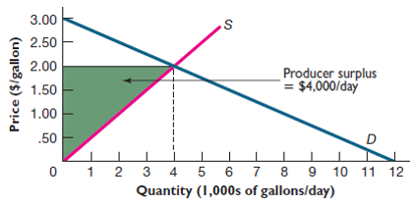
Producer Surplus
Producer surplus is the difference between the market price and the seller’s reservation price
Reservation price is on the supply curve
Producer surplus is the area above the supply curve and below the market price

Slide 40
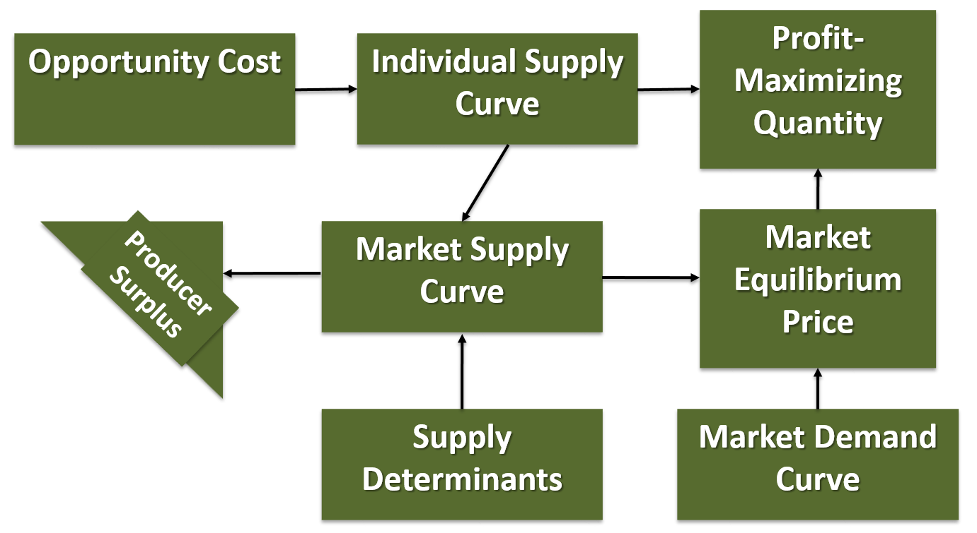
Supply

Slide 41
Accessibility Content: Text Alternatives for Images

Slide 42
Cost Curves Text Alternative
The average total cost curve, ATC, is a downward sloping curve originating at (80, .65) and intersecting points (200, 0.32), (260, 0.292), (300, 0.293), (330, 0.303), (350, 0.32), and (362, 0.343). The average variable cost, AVC, is a curve below ATC originating at (80, .15) and intersecting points (200, 0.12), (260, 0.138), (300, 0.16, (330, 0.182), (350, 0.206), and (362, 0.232). The marginal cost curve, MC originates at Cost=.15, dips below the AVC line and then slopes upward after output exceeds 200 bottles, intersects the AVC and ATC curve ending at Cost=.60.
Return to slide containing original image

Slide 43
Graphical Profit Maximization 1 Text Alternative
The average total cost curve, ATC, is a u-shaped curve that intersects point (200, .10) at the bottom of the curve. The average variable cost, AVC, is an upward sloping curve below ATC intersecting point (160, .07). The marginal cost curve, MC, originates below the AVC ant ATC lines and then slopes upward intersecting the AVC curve at (160, .07) and the ATC curve at (200, .10) and point (300, .30). The price line is a horizontal line at Cost=.20 that intersects the ATC curve at two points, the MC curve at (260, .20) and the AVC curve.
Return to slide containing original image

Slide 44
Graphical Profit Maximization 2 Text Alternative
The average total cost curve, ATC, is a u-shaped curve that intersects point (260, .12) on the right side of the curve. The average variable cost, AVC, is an upward sloping curve below ATC. The marginal cost curve, MC, originates below the AVC ant ATC lines and then slopes upward intersecting both curves and point (260,.20). The price line is a horizontal line at Cost=.20 that intersects the ATC curve at two points, the MC curve at (260,.20) and the AVC curve. The rectangular area on the graph from Cost=.12 to .20 over to Output=260 is shaded and labeled Profit = $20.80/day.
Return to slide containing original image

Slide 45
Losses Text Alternative
The average total cost curve, ATC, is a u-shaped curve that intersects point (180, .10) at the bottom of the curve. The average variable cost, AVC, is an upward sloping curve below ATC. The marginal cost curve, MC, originates below the AVC and ATC lines and then slopes upward intersecting both curves. The price line is a horizontal line at Cost=.08 that intersects the AVC curve at two points and the MC curve at (180, .08). The rectangular area on the graph from Cost=.08 to .10 over to Output=180 is shaded and labeled Profit = −$3.60/day.
Return to slide containing original image

